Slide 1
2D Feature Detectors and Descriptors
CV&ML reading group, 5/29
Presenter: You-Yi Jau, M.S. in UCSD

Slide 2
Outlines
Introduction
Motivation
Recap: Sift, Superpoint
LF-Net: Learning Local Features from Images
Both detector and descriptor
D2-Net: A Trainable CNN for Joint Detection and Description of Local Features
Both detector and descriptor
ContextDesc: Local Descriptor Augmentation with Cross-Modality Context
Descriptor

Slide 3
Motivation and problem description
Why 2D features?
Establishing pixel-level correspondences is important
Applications in 3D computer vision, video compression, tracking, image retrieval, and visual localization
Why sparse feature?
Correspondences can be matched efficiently via nearest neighbor search
Notes:
However, they typ- ically perform poorly under extreme appearance changes, e.g., between day and night [71] or seasons [46], or in weakly textured scenes [59].

Slide 4
Motivation and problem description
Why 2D features?
Establishing pixel-level correspondences is important
Applications in 3D computer vision, video compression, tracking, image retrieval, and visual localization
Why sparse feature?
Correspondences can be matched efficiently via nearest neighbor search
Sparse local features have been applied successfully under a wide range of imaging conditions. However, they typically perform poorly under extreme appearance changes.
local descriptors can still be matched successfully even if keypoints cannot be detected reliably
we propose a describe-and-detect approach to sparse local feature detection and description: Rather than performing feature detection early on based on low-level information, we propose to postpone the detection stage.
Notes:
However, they typ- ically perform poorly under extreme appearance changes, e.g., between day and night [71] or seasons [46], or in weakly textured scenes [59].

Slide 5
SIFT: strong baseline
Slide from Manmohan Chandraker.
CSE 252C: Advanced Computer Vision
Distinctive image features from scale-invariant keypoints
DG Lowe - International journal of computer vision, 2004

Slide 6
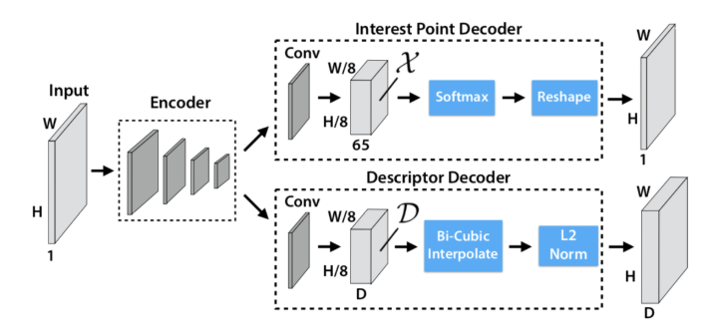
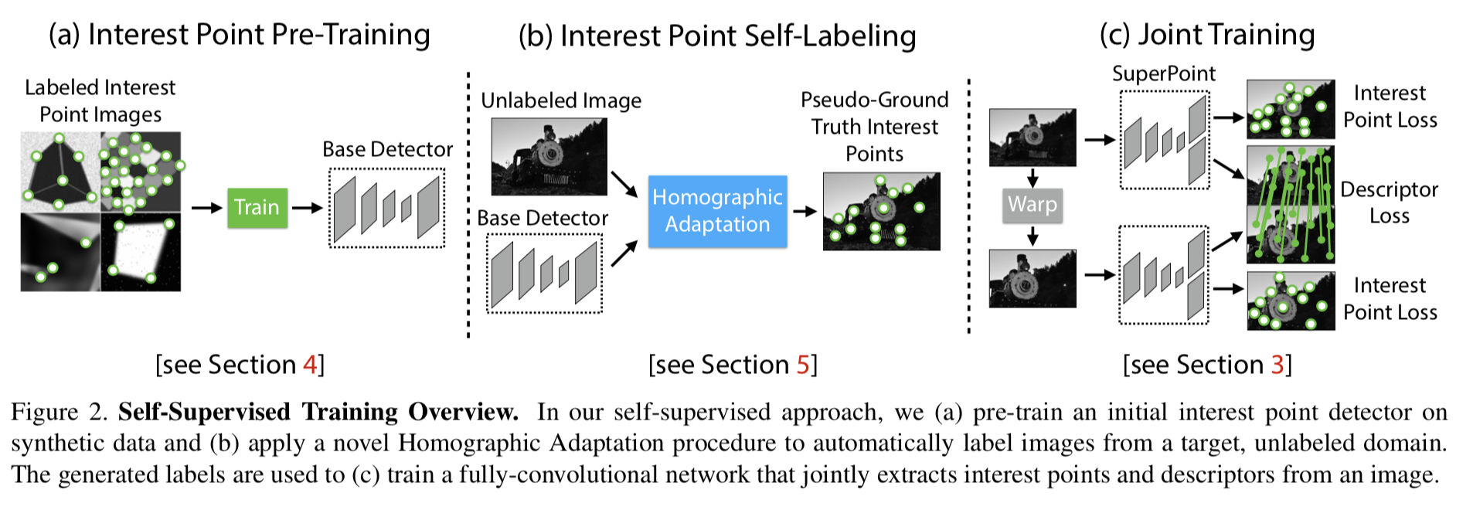
Superpoint (CVPR’18)

Slide 7
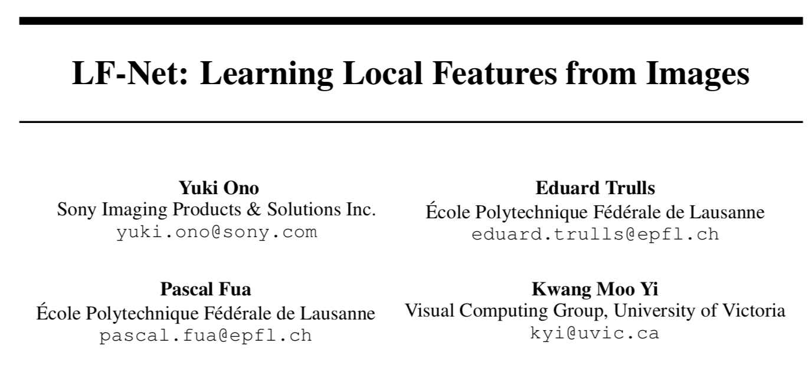
NIPS 2018
LF-Net: learning local features from images
Y Ono, E Trulls, P Fua, KM Yi - Advances in Neural Information Processing Systems, 2018

Slide 8
Highlights
LF-Net: Local Feature Network
Contribution
Trainable end-to-end
use image pairs: relative pose and corresponding depth maps
Notes:
sparse-matching method

Slide 9
Motivation and problem description
Contribution
we propose a sparse-matching method with a novel deep architecture, which we name LF-Net, for Local Feature Network
we use image pairs for which we know the relative pose and corresponding depth maps

Slide 10
Method overview
learn a local feature pipeline from scratch, using collections of images without the need for human supervision.
we exploit depth and relative camera pose cues to create a virtual target that the network should achieve on one image

Slide 11
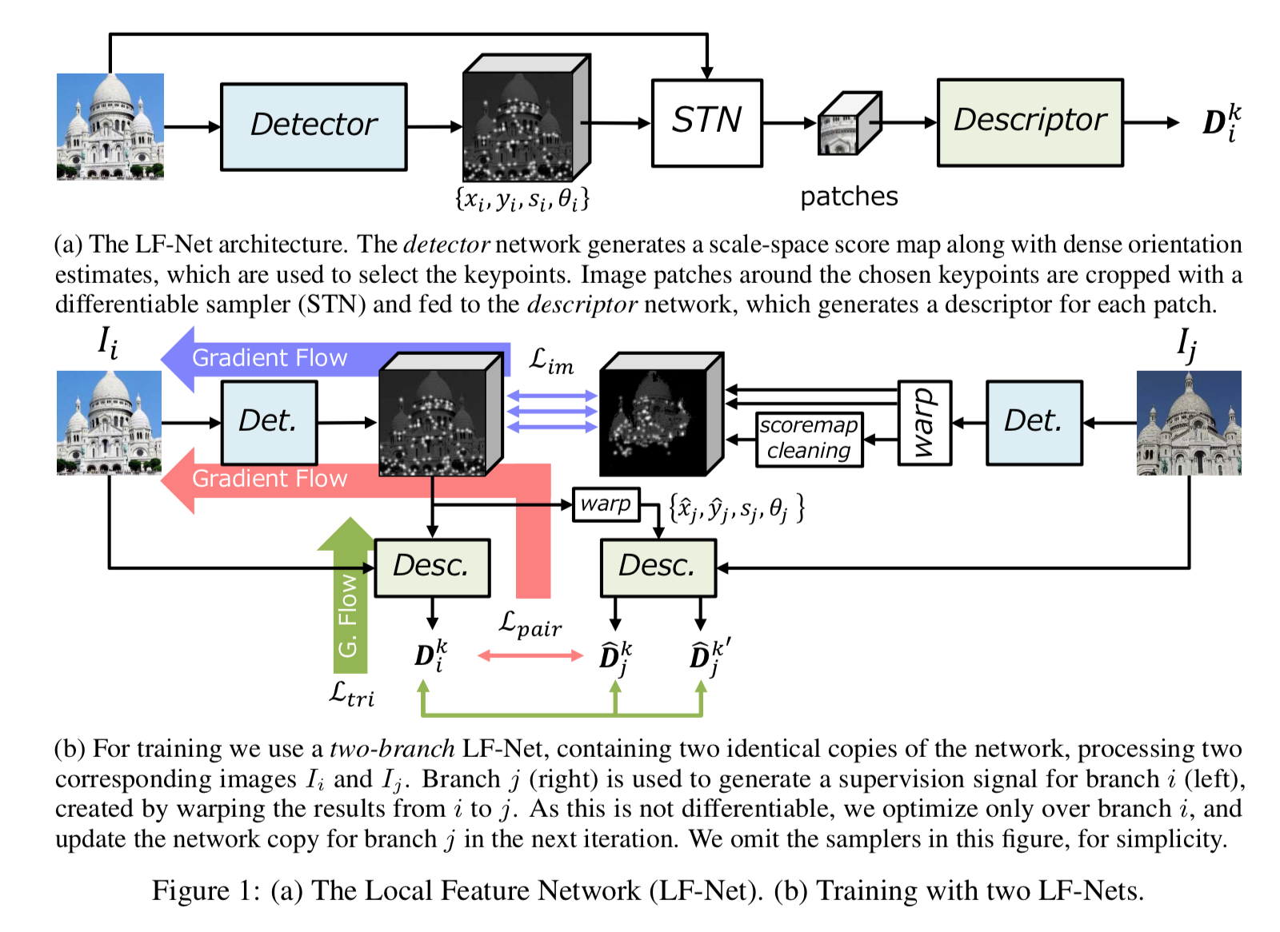
Pipeline

Slide 12
Pipeline

Slide 13
Loss
Final Loss
Detector consistency loss: known correspondences

Slide 14
Loss
Descriptor loss
triplet loss

Slide 15
Method details and analysis
Detector
dense, multi-scale, fully convolutional network
predict keypoint locations, scales, and orientations
Descriptor
given patches cropped around the keypoints
outputs local descriptors

Slide 16
Method details and analysis
Detector
The first network is a dense, multi-scale, fully convolutional network that returns keypoint locations, scales, and orientations.
Descriptor
The second is a network that outputs local descriptors given patches cropped around the keypoints produced by the first network.

Slide 17
Detector details
Feature map: model
ResNet blocks
same output size as the input
Scale
5 layers
heatmap → softmax over patches → softmax over different scales → top K pixels as keypoints → softargmax (sub-pixel)
Orientation estimation
5 x 5 convolution on heatmap → predict cos𝜃, sin𝜃

Slide 18
Detector details
Feature map: model
ResNet layout with three blocks
Each block contains 5 x 5 convolutional filters followed by batch normalization, leaky-ReLU activations, and another set of 5 x 5 convolutions.
same output size as the input, and have 16 output channels
Scale
uniform intervals between 1/R and R, where N = 5 and R = 2^(0.5)
heatmap → softmax over patches → softmax over different scales → top K pixels as keypoints → softargmax (sub-pixel)
Orientation estimation
5 x 5 convolution on heatmap → predict cos𝜃, sin𝜃

Slide 19
Descriptor details
patch size: 32 x 32
Model:
three 3 X 3 convolutional filters with a stride of 2 and 64, 128, and 256 channels respectively.
And fully-connected 512-channel layer

Slide 20
Descriptor details
crop them from the normalized images and resize them to 32 x 32
Model:
Our descriptor network comprises three 3 X 3 convolutional filters with a stride of 2 and 64, 128, and 256 channels respectively. And fully-connected 512-channel layer

Slide 21
Training data

Slide 22
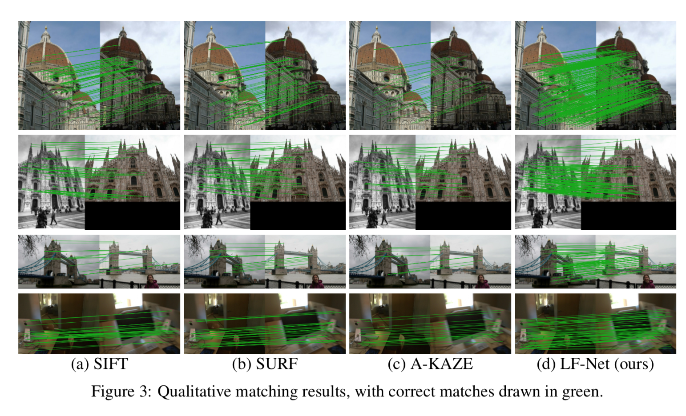
Qualitative results

Slide 23
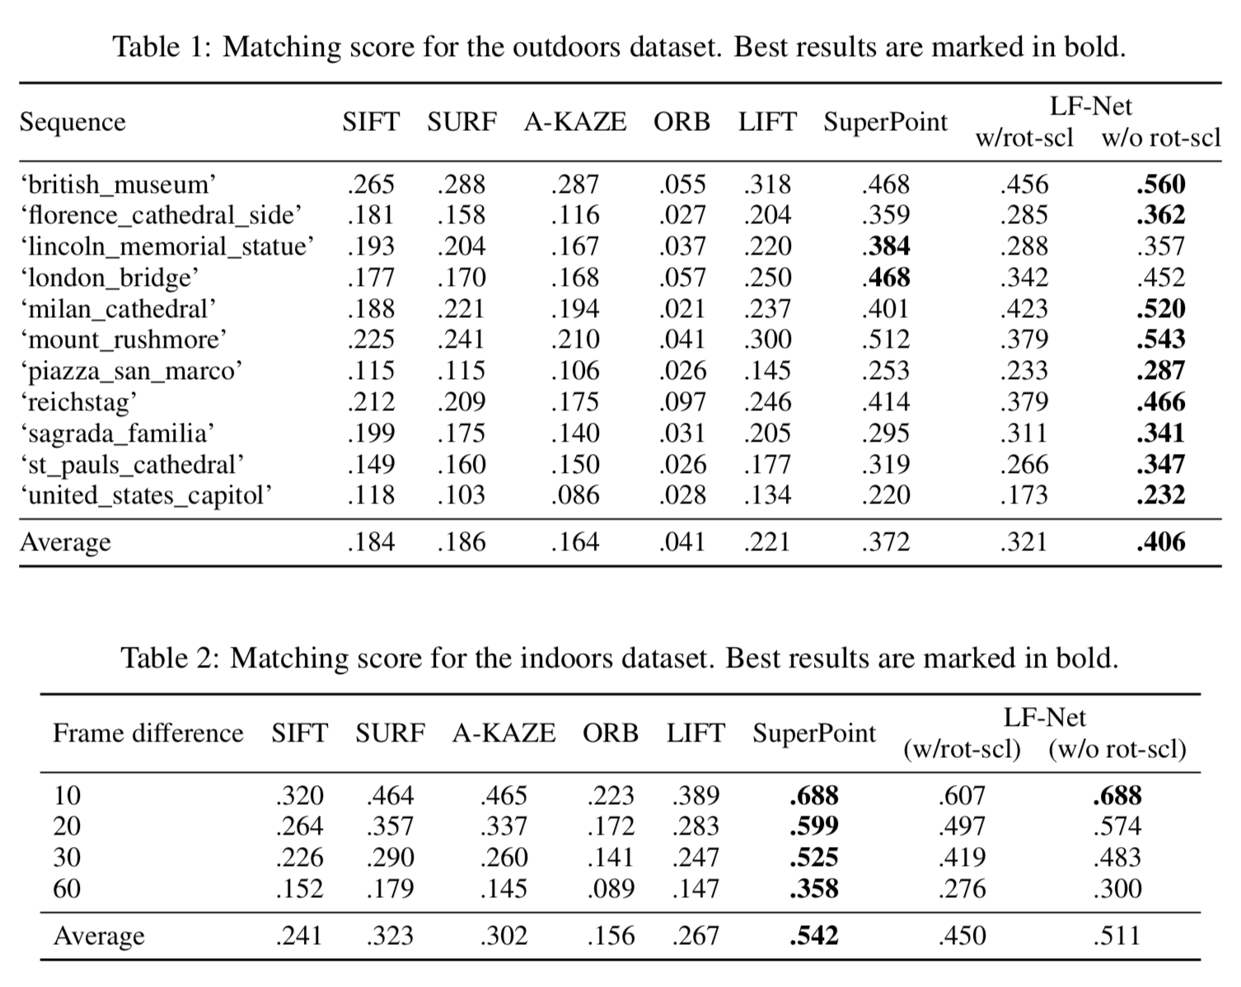
Matching score on indoor and outdoor
w/ rot-scl:
data augmentation

Slide 24
In short
LF-Net is deep learning approach for detector and descriptor
Detector and descriptor do not share parameters
Use output from off-the-shelf SFM method as supervision

Slide 25
Future work and discussion
How good can LF-Net work on structure from motion task, compared to SIFT?

Slide 26
Questions?

Slide 27
CVPR 2019
D2-Net: A Trainable CNN for Joint Detection and Description of Local Features
M Dusmanu, I Rocco, T Pajdla, M Pollefeys, J Sivic… - arXiv preprint arXiv …, 2019

Slide 28
Motivation and problem description
Why feature?
Establishing pixel-level correspondences is important
Applications in 3D computer vision, video compression, tracking, image retrieval, and visual localization
Why sparse feature?
Correspondences can be matched efficiently via nearest neighbor search
Sparse local features have been applied successfully under a wide range of imaging conditions. However, they typically perform poorly under extreme appearance changes.
local descriptors can still be matched successfully even if keypoints cannot be detected reliably
we propose a describe-and-detect approach to sparse local feature detection and description: Rather than performing feature detection early on based on low-level information, we propose to postpone the detection stage.
Notes:
However, they typ- ically perform poorly under extreme appearance changes, e.g., between day and night [71] or seasons [46], or in weakly textured scenes [59].

Slide 29
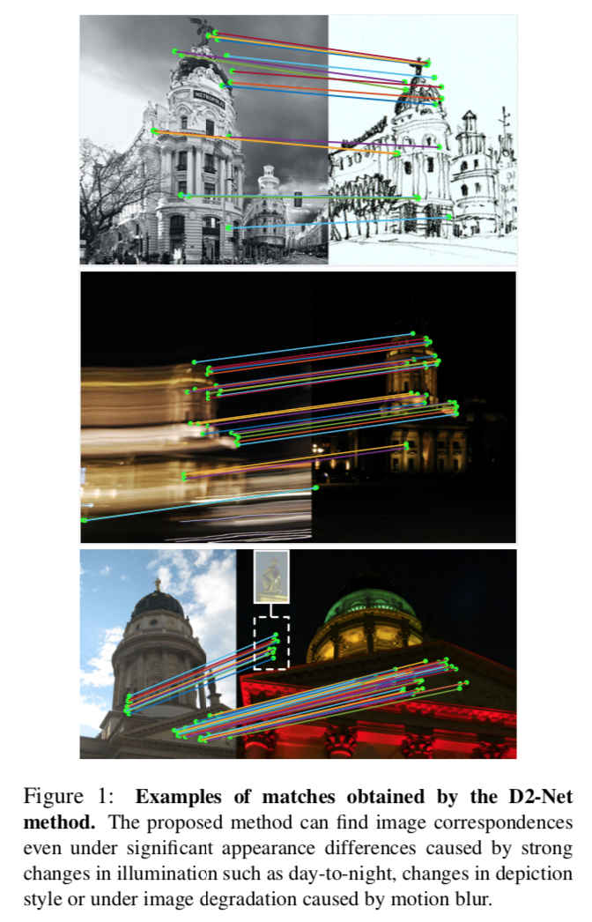
Qualitative results

Slide 30
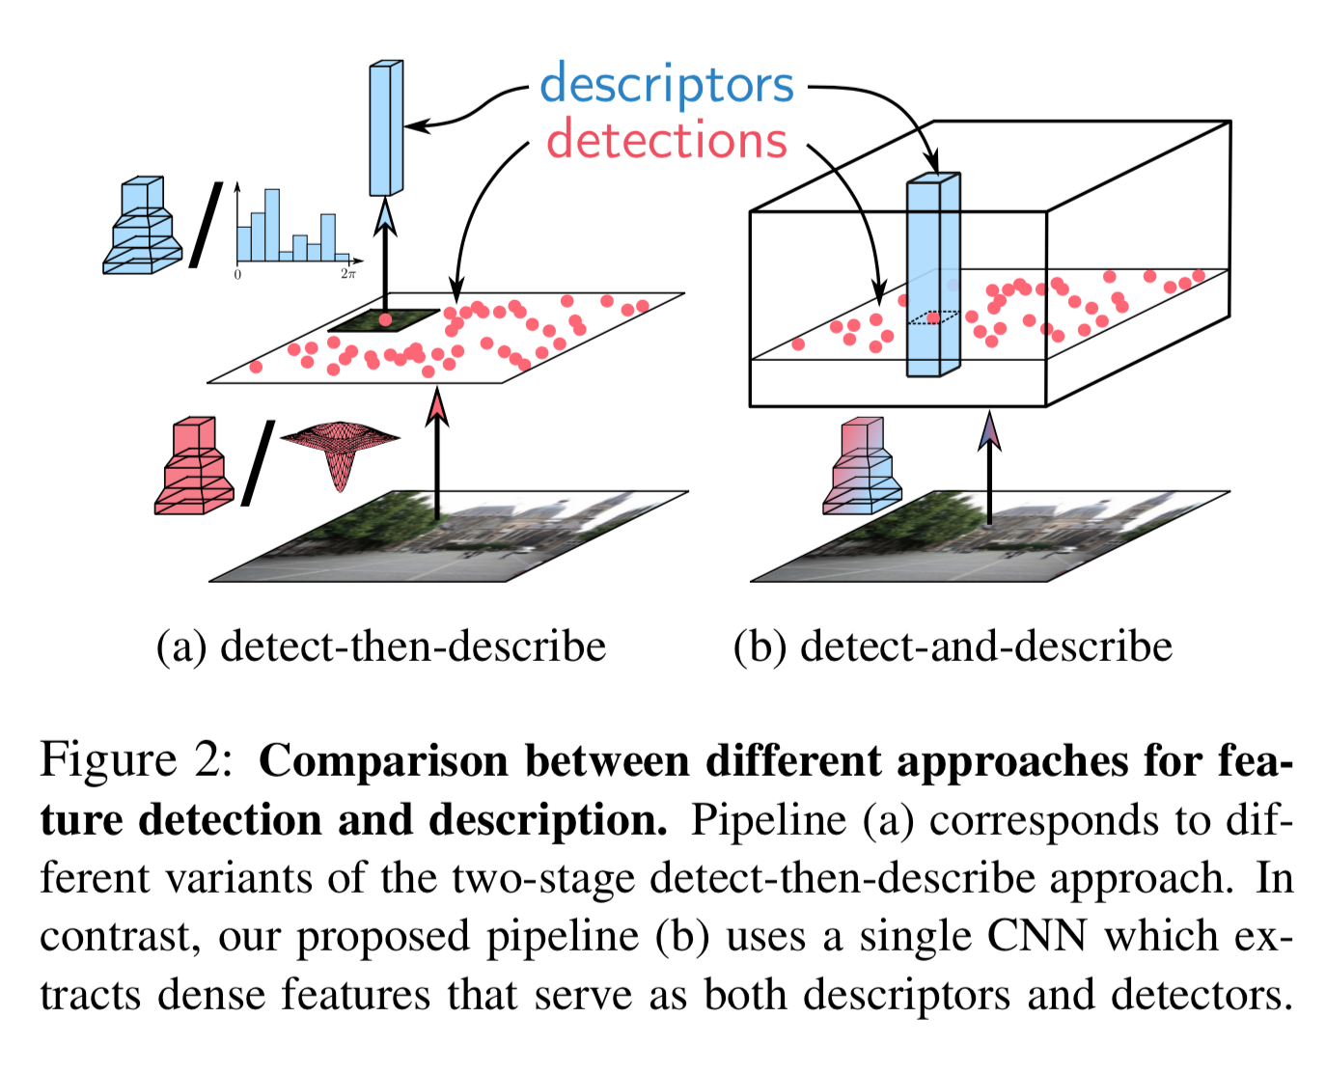
Main idea
Change from detect-then-describe to detect-and-describe
shares all parameters between detection and description
perform dense feature extraction for both detector and descriptor

Slide 31
Prior work
Local features
SIFT
SuperPoint: shares a deep representation between detection and description
Dense descriptor extraction and matching.
Christopher B. Choy, JunYoung Gwak, Silvio Savarese, andManmohan Chandraker. Universal Correspondence Net-work. In NIPS, 2016.
Image retrieval.
Object detection.

Slide 32
Method overview
shares all parameters between detection and description
perform dense feature extraction for both detector and descriptor

Slide 33
Method overview
On the contrary, our method shares all parameters between detection and description and uses a joint formulation that simultaneously optimizes for both tasks.
Contrary to the classical detect-then-describe ap- proaches, which use a two-stage pipeline, we propose to perform dense feature extraction to obtain a representation that is simultaneously a detector and a descriptor. Because both detector and descriptor share the underlying represen- tation, we refer to our approach as D2.

Slide 34
Pipeline
Pretrained VGG16 feature extractor as initialization

Slide 35
Pipeline
Descriptor
directly get from feature map

Slide 36
Pipeline
Detector
Soft local-max with neighbors → channel-wise NMS → max across feature maps

Slide 37
Loss
Descriptor + Detector
Weighted triplet loss

Slide 38
In traditional feature detectors such as DoG, the detection map would be sparsified by performing a spatial non-local-maximum suppression.
However, in our approach, contrary to traditional feature detectors, there exist multiple detection maps

Slide 39
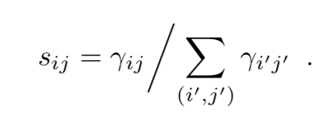
Get feature points
Hard feature detection
Soft feature detection.

Slide 40
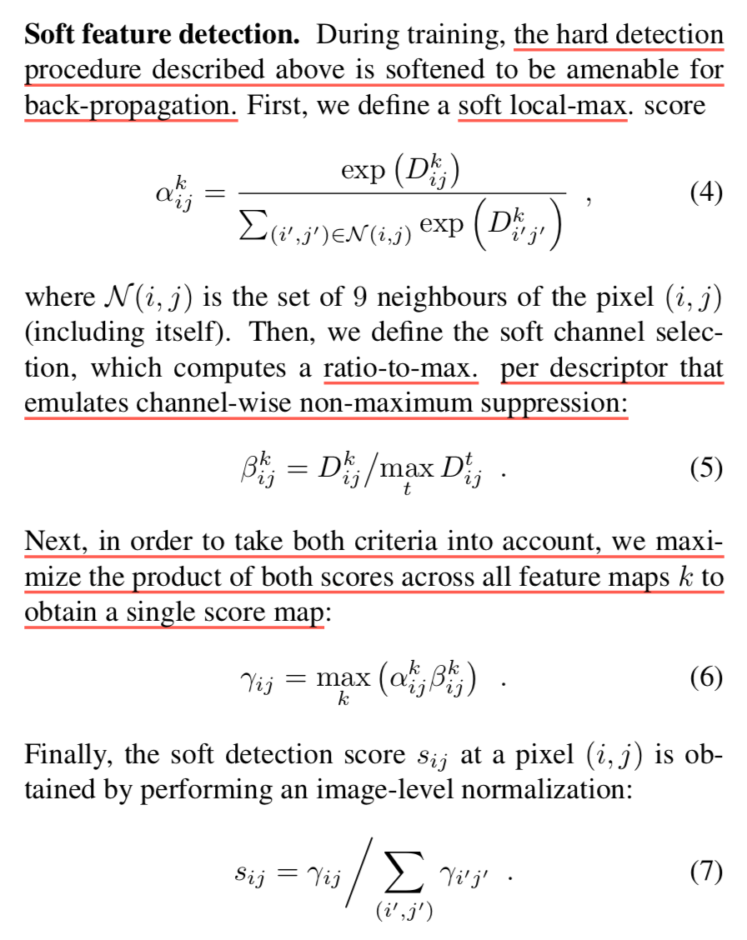

Slide 41
Multiscale detection at test time
Multiscale Detection
we propose to use an image pyramid
This is only performed during test time.
ro = 0.5, 1, 2
Note that the feature maps F_ro have different resolutions.

Slide 42
Method details and analysis
Loss
Descriptor: triplet margin ranking loss
Descriptor + Detector:
weighted descriptor loss

Slide 43
Method details and analysis
Loss
Descriptor: triplet margin ranking loss
Descriptor + Detector:
The proposed loss produces a weighted average of the margin terms m over all matches based on their detection scores.
Thus, in order for the loss to be minimized, the most distinctive correspondences (with a lower margin term) will get higher relative scores and vice-versa

Slide 44
Training Data
Training Data
MegaDepth dataset consisting of 196 different scenes reconstructed from 1,070,468 internet photos using COLMAP

Slide 45
Experiments
Image Matching
Hpatches
Worse for stricter matching threshold
Notes:
our method performs worse than detect-then-describe approaches for stricter matching thresholds: The latter use detectors firing at low-level blob- like structures, which are inherently better localized than the higher-level features used by our approach.

Slide 46
3D Reconstruction
MVS

Slide 47
Experiments
Localization under challenging Conditions
Day-Night Visual Localization
Benchmarking 6dof outdoor visual localization in changing conditions
T Sattler, W Maddern, C Toft, A Torii, L Hammarstrand… - Proceedings of the IEEE …, 2018, CVPR(SPOT)

Slide 48
Qualitative results

Slide 49
Qualitative results
Soft detection scores for different scenes

Slide 50
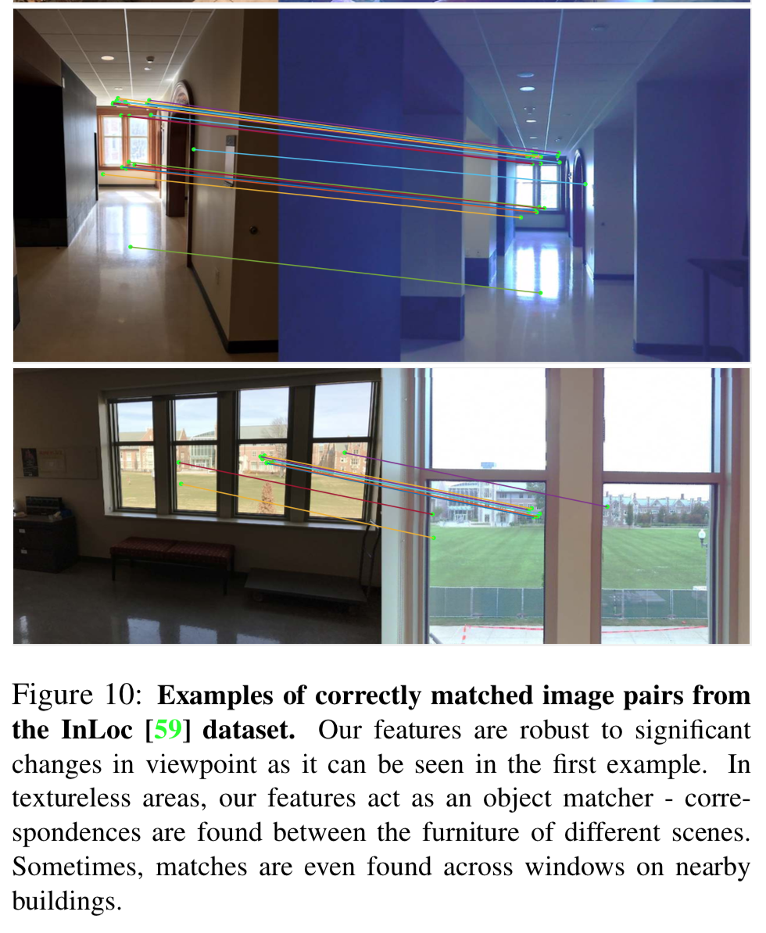
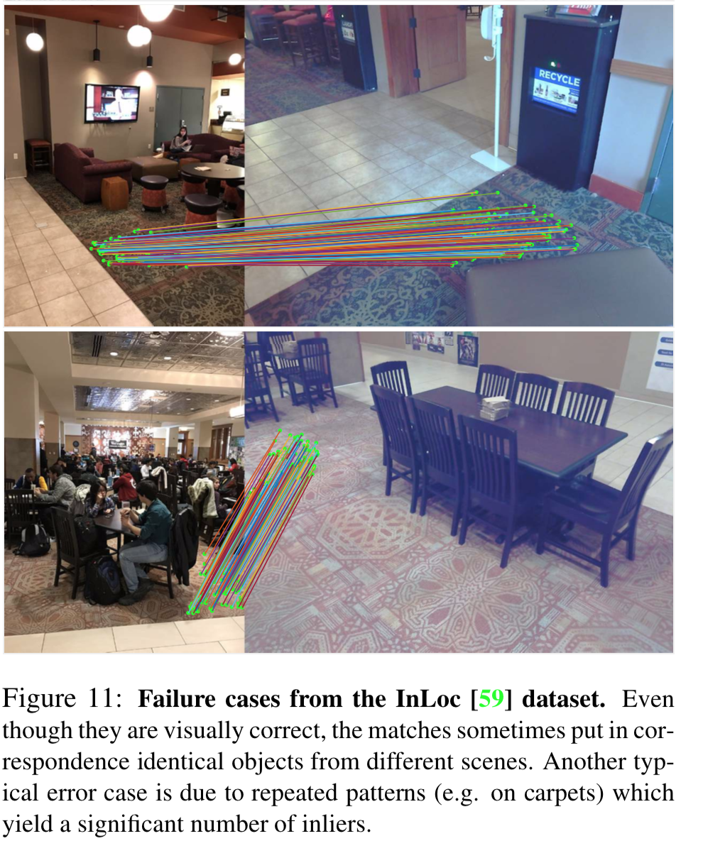
Qualitative results - InLoc

Slide 51
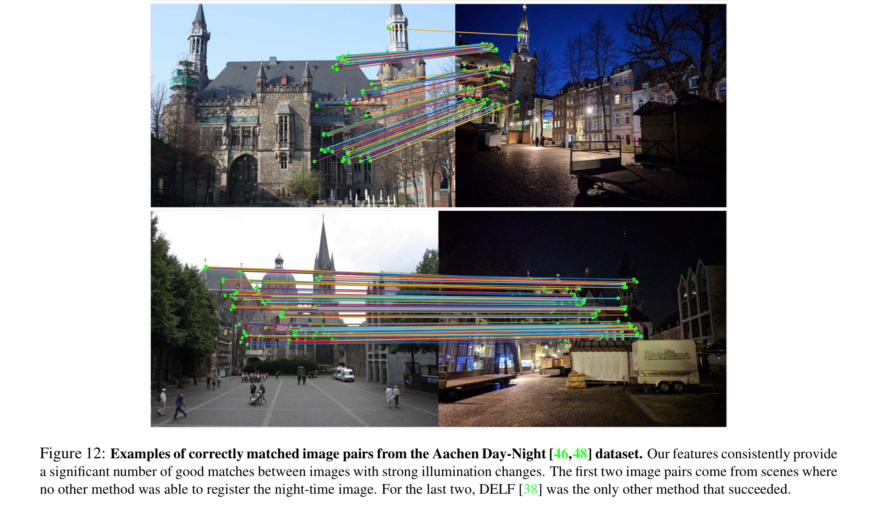
Qualitative results – Day-Night

Slide 52
In short
D2-Net is deep learning approach for detector and descriptor
One representation for both detector and descriptor
Use outputs from off-the-shelf SFM method as supervision
Weighted triplet loss

Slide 53
Future work and discussion
Feature points are not accurate
Keep the resolution of image features
low resolution (1/8) when training

Slide 54
Questions?

Slide 55
CVPR 2019 (oral)
ContextDesc: Local Descriptor Augmentation with Cross-Modality Context
Z Luo, T Shen, L Zhou, J Zhang, Y Yao, S Li, T Fang… - arXiv preprint arXiv …, 2019

Slide 56
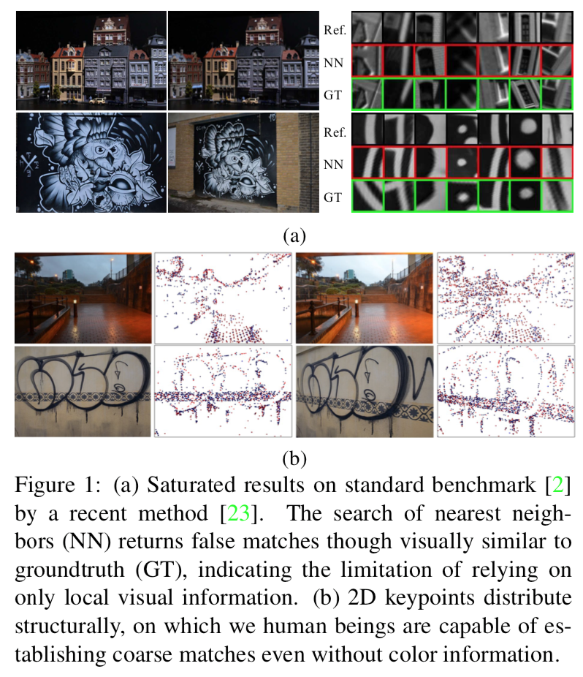
Motivation and problem description
Why local feature descriptor?
panorama stitching, wide-baseline matching, image retrieval and structure-from-motion (SfM)
What is the challenge?
repetitive patterns
visually indistinguishable from ground truth
What is the goal?
feature description with extra prior knowledge
effectively combine the local feature description and off-the-shelf visual understandings
Notes:
Why visual odometry?
GPS not sufficient. Real-time localization.
Why semi-direct method?
- We don’t need sift features. We still need features and patches to recover the pose. Therefore, it is called semi-dense.
Input/ output
monocular/ pose

Slide 57
Motivation and problem description
Why local feature descriptor?
panorama stitch- ing [21], wide-baseline matching [24, 54, 55], image re- trieval [27] and structure-from-motion (SfM)
What is the challenge?
due to repetitive patterns, the matching algorithm often finds false matches as nearest neighbors that are vi- sually indistinguishable from groundtruth
What is the goal?
we seek to enhance the local feature description with extra prior knowledge, which we refer to as introducing context awareness to augment local feature descriptors.
Previously, a multi-scale-like architecture can help to capture visual context of different levels
we strive to effectively combine the local feature description and off-the-shelf visual understandings so as to go beyond the local detail representation.
Notes:
Why visual odometry?
GPS not sufficient. Real-time localization.
Why semi-direct method?
- We don’t need sift features. We still need features and patches to recover the pose. Therefore, it is called semi-dense.
Input/ output
monocular/ pose

Slide 58
Contributions
A novel visual context encoder
high-level visual understandings
A novel geometric context encoder
unordered points and exploits geometric cues
A novel N-pair loss
requires no manual hyper-parameter search
better convergence properties.

Slide 59
Contributions
Contributions
a novel visual context encoder that integrates high-level visual understandings from regional image representation, a technique often used by image retrieval
A novel geometric context encoder that consumes unordered points and exploits geometric cues from 2D keypoint distri-bution, while being robust to complex variations.
A novel N-pair loss that requires no manual hyper-parameter search and has better convergence properties.

Slide 61
Prior work
Learned local descriptors
take individual image patches as input
Medium: LSD-slam and ORB-slam2, a literature based explanation
Notes:
Visual Motion Estimation Methods
Feature-based method
feature detectors and descriptors that allow matching between images even at large inter-frame movement
the neccessity for robust estimation techniques to deal with wrong correspondences
Direct method
estimate struc- ture and motion directly from intensity values in the image
outperform feature-based methods in terms of robustness in scenes with little texture [14] or in the case of camera- defocus and motion blur
he computation of the photometric error is more intensive than the reprojection error

Slide 62
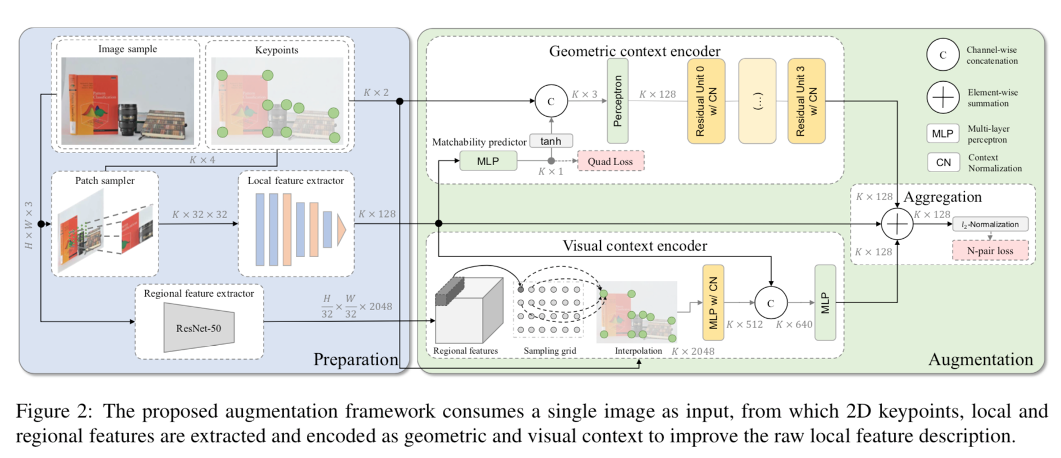
Method overview

Slide 63
Preparation module
Patch sampler
SIFT feature detector
32 x 32 gray-scale patches
sampled by a spatial transformer from SIFT
Local feature extractor
takes image patches as input, producing 128-d feature descriptions as output
7-layer CNN
Regional feature extractor
features from an off-the-shelf deep image retrieval model of ResNet-50

Slide 64
Visual context encoder
kNN interpolation
concatenate raw local features and regional features
Pass through MLPs, forming the final 128-d features.
Notes:
previous work: max-pools over all dimensions of regional features.

Slide 65
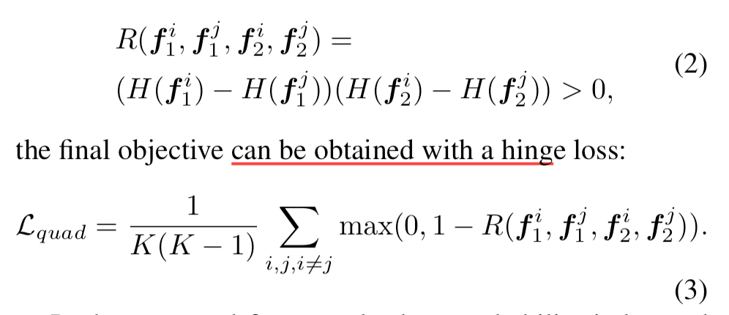
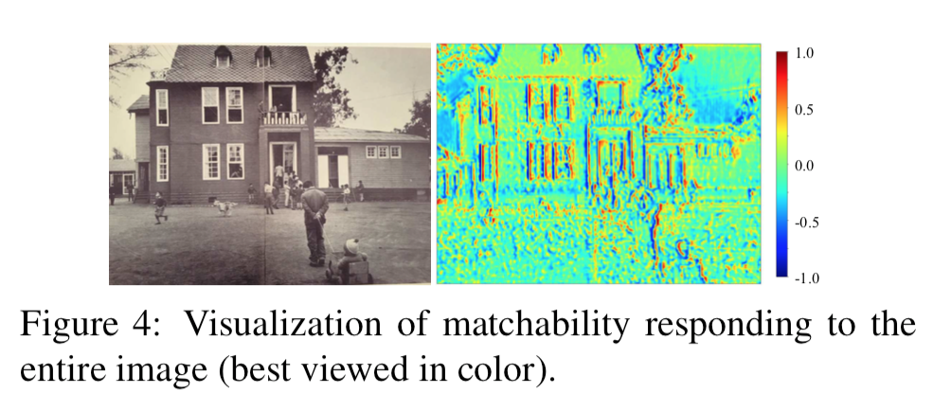
Geometric context encoder
This module takes K unordered points as input, and outputs 128-d corresponding feature vectors.
point coordinates
Matchability predictor
Notes:
unsupervised, consistency

Slide 66
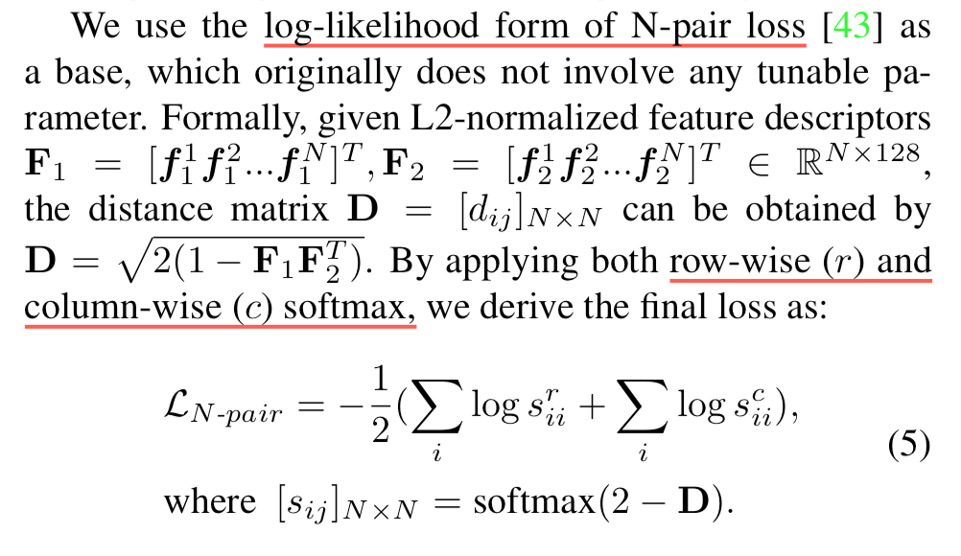
Loss
N-pair loss
positive pairs closer
negative pairs farther

Slide 67
Feature aggregation
element-wise summation and L2-normalization
same feature dimensionality
Flexible
still work when only geometric context is available
Notes:
in situations where regional features are not available, one may aggregate with only geometric context without the need of retraining the model.

Slide 68
Method overview

Slide 69
Visual context encoder
In our framework, the global feature can be derived by applying Maximum Activations of Convolutions (MAC) aggregation, which simply max-pools over all dimensions of regional features.
kNN interpolation
Finally, raw local features are concatenated and further mapped by MLPs, forming the final 128-d features.

Slide 70
Implementation details
Training dataset.
large-scale photo-tourism and aerial datasets (GL3D), and generate ground truth matches from SfM
Data augmentation

Slide 71
Experiments
Matchings on Hpatches
Recall = # Correct Matches / # Correspondences

Slide 72
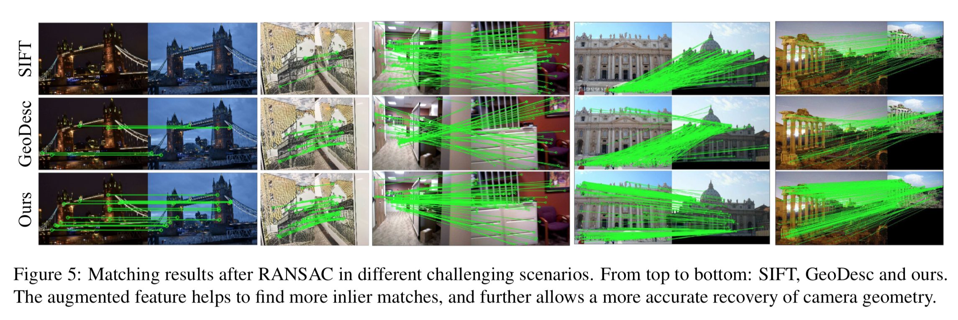

Slide 73
In short
Only descriptor
Local patches (VGG-like) + global features (ResNet) + Point coordinates (PointNet)

Slide 74
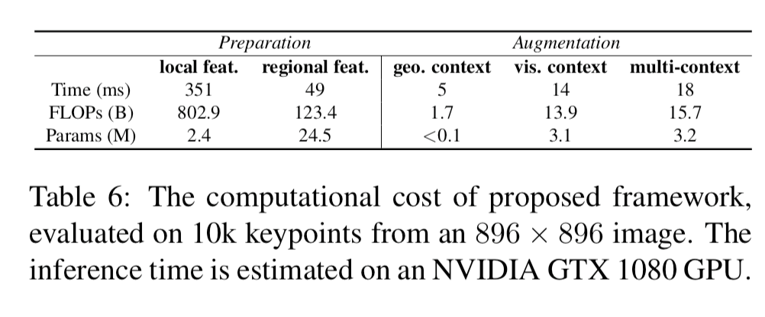
Future work and discussion
Computational cost
Slow
End-to-end training
we freeze only the regional model and train from scratch with Eq. 7 on the augmented feature
end-to-end train with the regional model. No improvement.

Slide 75
Questions?

Slide 76
Takeaways
SIFT is robust with subpixel accuracy
LF-Net: softargmax
Change backbone: receptive field vs. efficiency
Training dataset is from COLMAP

Slide 77
Thank you

Slide 78
Backup

Slide 79
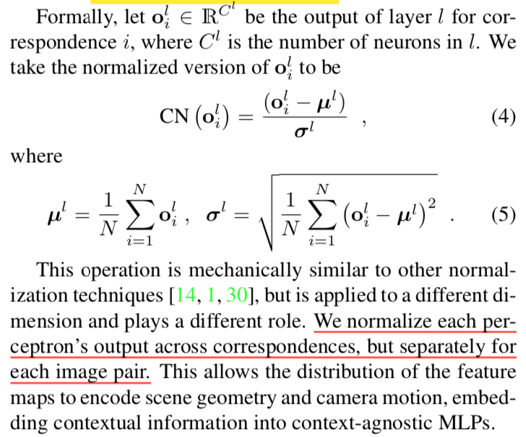
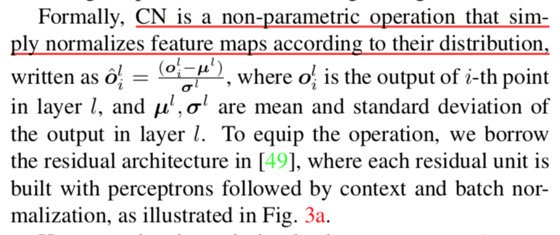
Context normalization
Learning to find good correspondences
KM Yi, E Trulls Fortuny, Y Ono, V Lepetit, M Salzmann… - Proceedings of the 2018 …, 2018

