Slide 1
Deep Visual Odometry
CV&ML reading group, 2020/01/31
Presenter: You-Yi Jau, M.S. in UCSD

Slide 2
Outlines
Motivation and problem description
Brief summary of recent works
Self-Supervised 3D Keypoint Learning for Ego-motion Estimation
Optional: Visual Odometry Revisited: What Should Be Learnt?

Slide 3
Outlines
Motivation and problem description
Brief summary of recent works
Self-Supervised 3D Keypoint Learning for Ego-motion Estimation
Optional: Visual Odometry Revisited: What Should Be Learnt?

Slide 4
Motivation and problem description
Why visual odometry?
Localization
Mapping
Classic methods
ORB-SLAM: https://www.youtube.com/watch?v=IuBGKxgaxS0
Why deep learning?
Challenging scenes: textureless, lighting, indoor, outdoor
Hand-crafted → Optimize the system end-to-end
Notes:
However, they typ- ically perform poorly under extreme appearance changes, e.g., between day and night [71] or seasons [46], or in weakly textured scenes [59].

Slide 5
Brief summary of recent works
Pure deep learning visual odometry
Beyond tracking: LSTM, relative pose, absolute pose
Beyond tracking: Selecting memory and refining poses for deep visual odometry
F Xue, X Wang, S Li, Q Wang, J Wang, H Zha - … of the IEEE Conference on Computer …, 2019
DSVO: predict left frame from right frame
Deep virtual stereo odometry: Leveraging deep depth prediction for monocular direct sparse odometry
N Yang, R Wang, J Stuckler, D Cremers - … of the European Conference on Computer …, 2018
Not pure deep learning visual odometry
Self-Supervised 3D Keypoint Learning for Ego-motion Estimation
Visual Odometry Revisited: What Should Be Learnt?

Slide 6
Outlines
Motivation and problem description
Brief summary of recent works
Self-Supervised 3D Keypoint Learning for Ego-motion Estimation
Optional: Visual Odometry Revisited: What Should Be Learnt?

Slide 7
Self-Supervised 3D Keypoint Learning for Ego-motion Estimation
J Tang, R Ambrus, V Guizilini, S Pillai, H Kim, A Gaidon - arXiv preprint arXiv …, 2019

Slide 8
Highlights
Self-supervised training with multi-view adaptation
Notes:
sparse-matching method

Slide 9
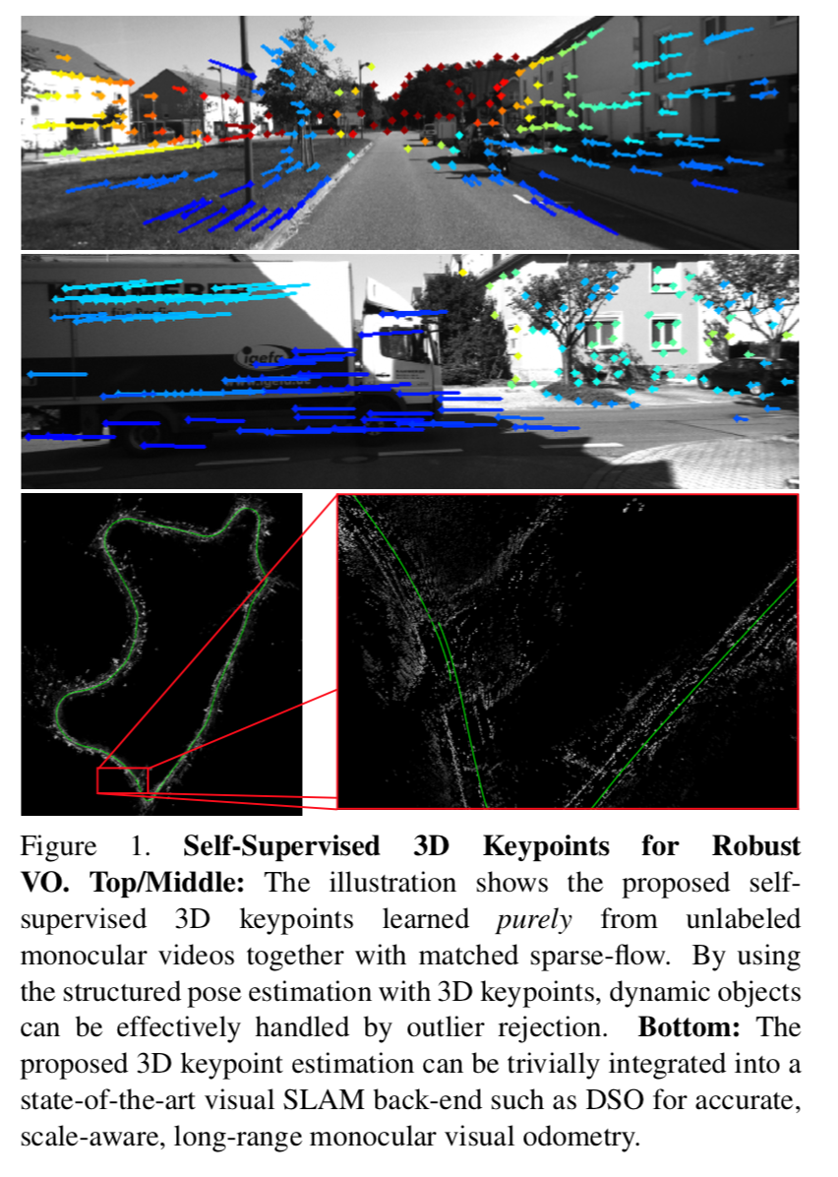
Motivation and problem description
Keypoint matching is essential for Sfm, visual odometry (VO), SLAM
Hand-engineered (SIFT) feature detectors and descriptors are dominant algorithms
Deep learning methods drew attention (Superpoint)

Slide 10
Motivation and problem description
Contribution
Fully self-supervised framework for the learning of depth-aware keypoint detection and description from unlabeled videos
3D multi-view adaptation, a novel adaptation technique that exploits the temporal context in videos
Integrating with a state-of-the-art tracking method such as Direct Sparse Odometry (DSO)

Slide 11
Prior works
Learning-based methods for keypoint estimation
Supervised method: LIFT (Kwang et al.), LF-Net (Yuki et al.)
Self-supervised: Superpoint (Daniel et al.), Unsuperpoint (Peter et al.)
Learning-based methods for visual odometry
Sfm-learner (Zhou et al.)
Visual odometry revisited (Huangying et al.)

Slide 12
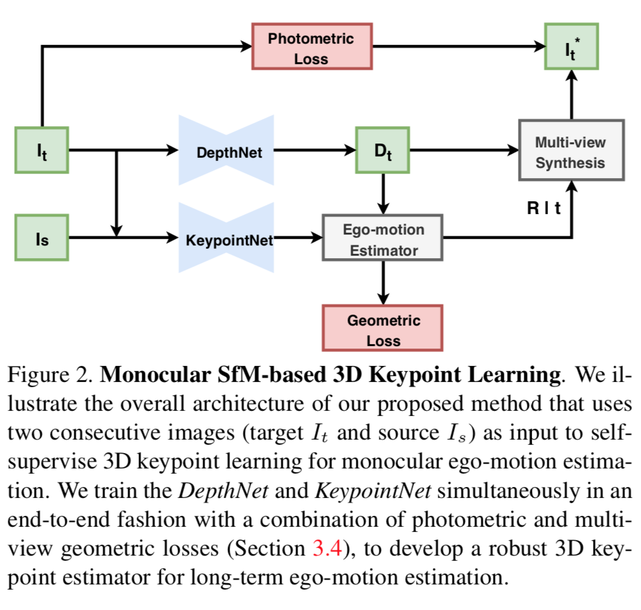
Overview: Pipeline
Depth prediction
Keypoint prediction

Slide 13
Networks
Input/ Output
DepthNet
RGB Image → “Scale-ambiguous” dense (inverse) depth map D
[20] Cle ́ment Godard, Oisin Mac Aodha, and Gabriel J. Bros- tow. Unsupervised monocular depth estimation with left- right consistency. In CVPR, 2017.
KeypointNet
RGB Image → k = {p, f, s} = {locations: Nx2, descriptors: Nx256, scores}
[4] Anonymous. Neural outlier rejection for self-supervised keypoint learning. In Submitted to International Conference on Learning Representations, 2020. under review.
Same author. (Guess accepted in ICLR 2020.)

Slide 14
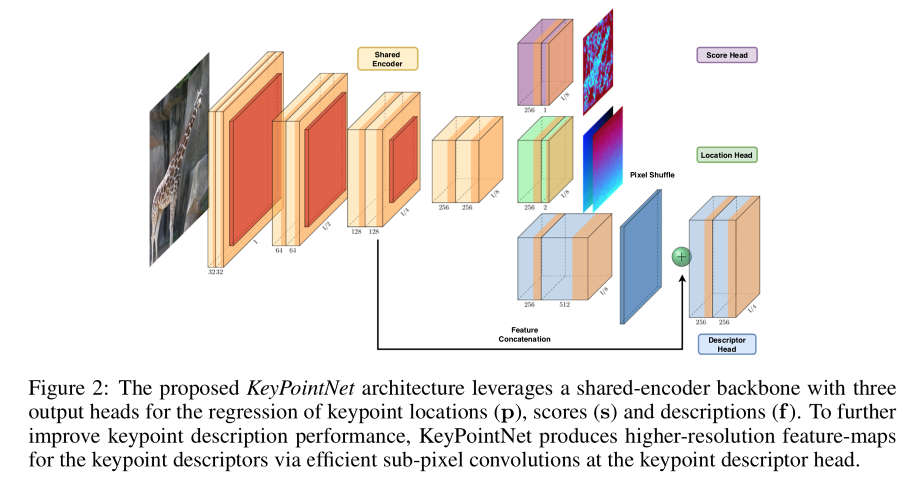
Network architecture
Neural Outlier Rejection for Self-Supervised Keypoint Learning
J Tang, H Kim, V Guizilini, S Pillai, R Ambrus - arXiv preprint arXiv:1912.10615, 2019

Slide 15
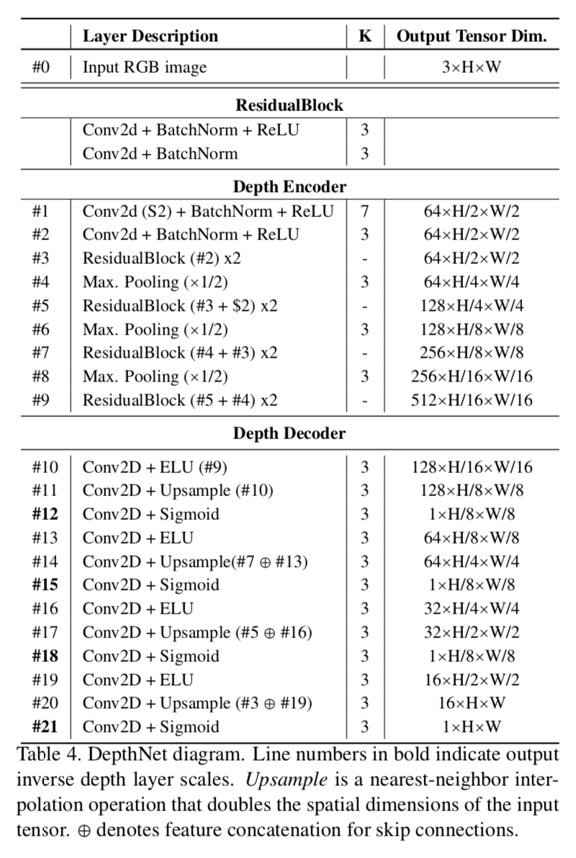
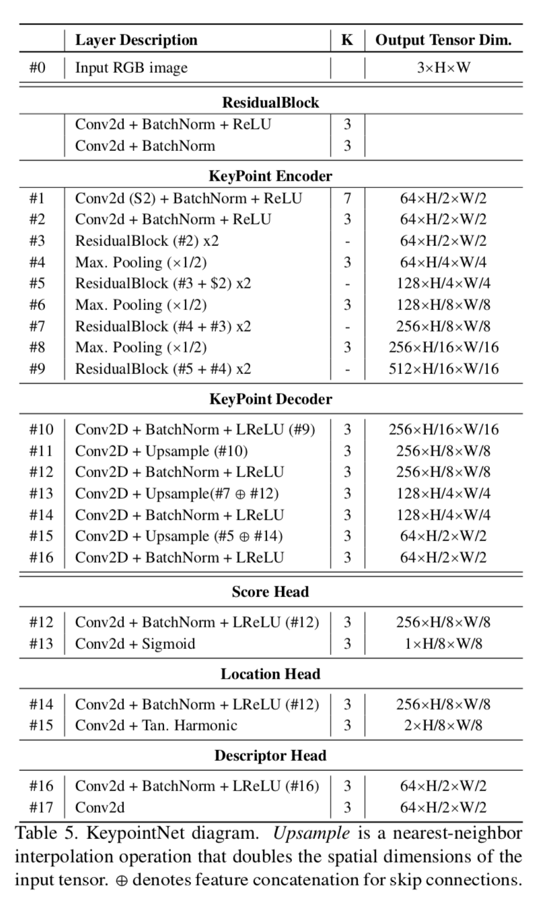
Network architecture

Slide 16
Loss function
Photometric loss
Dense
Image synthesis
Geometric loss
Sparse
Re-projection in the monocular two-view setting

Slide 17
Key idea of loss function
Homography adaptation vs. multi-view adaptation (use both)

Slide 18
Loss function in detail
Differentiable pose estimation from 2D-3D correspondences
3D residuals
SVD for closed-form solution
Why need to be differentiable

Slide 19
Loss function in detail
Keypoint loss
Descriptor matched keypoints ←→ 3D adapted keypoints (localization loss)
Descriptor loss
Triplet loss, hard sample mining
Score loss
Same scores across frames
High scores on good keypoints
2D Re-projection error

Slide 20
Loss function in detail
Photometric loss
Loss on SSIM
Depth smoothness loss
Edge-aware term
Depth Consistency
Discourage scale-drift between dense depth predictions in adjacent frames
Overall loss

Slide 21
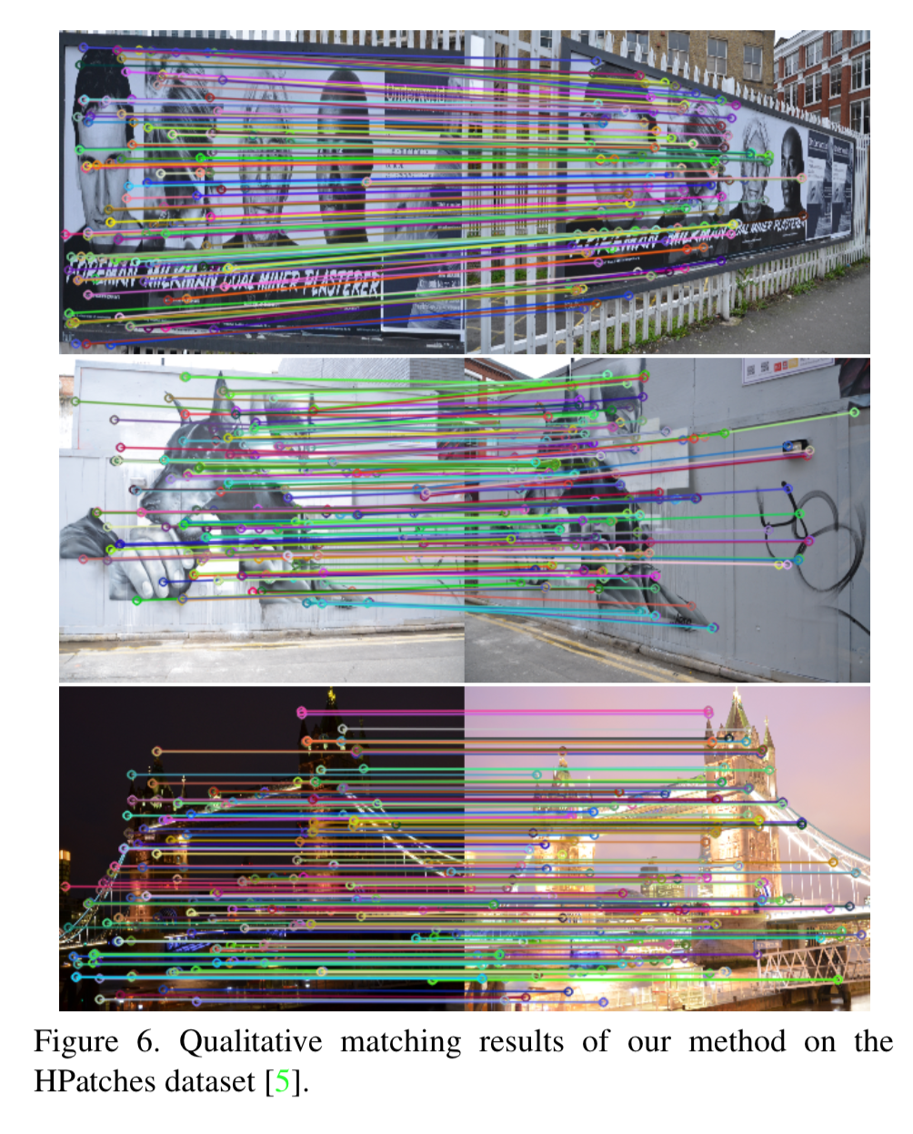
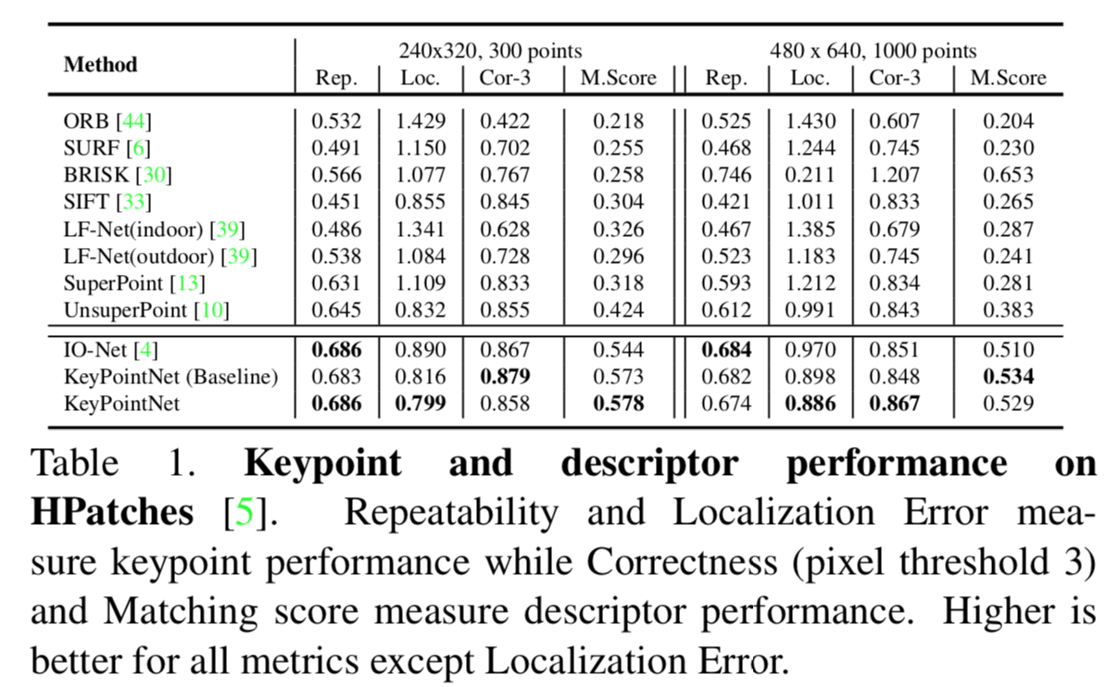
Detector and descriptor evaluation
Work the best among those

Slide 22
Experiments
Frame-to-frame (F2F)
Deep Semi-Direct Sparse Odometry (DS-DSO)

Slide 23
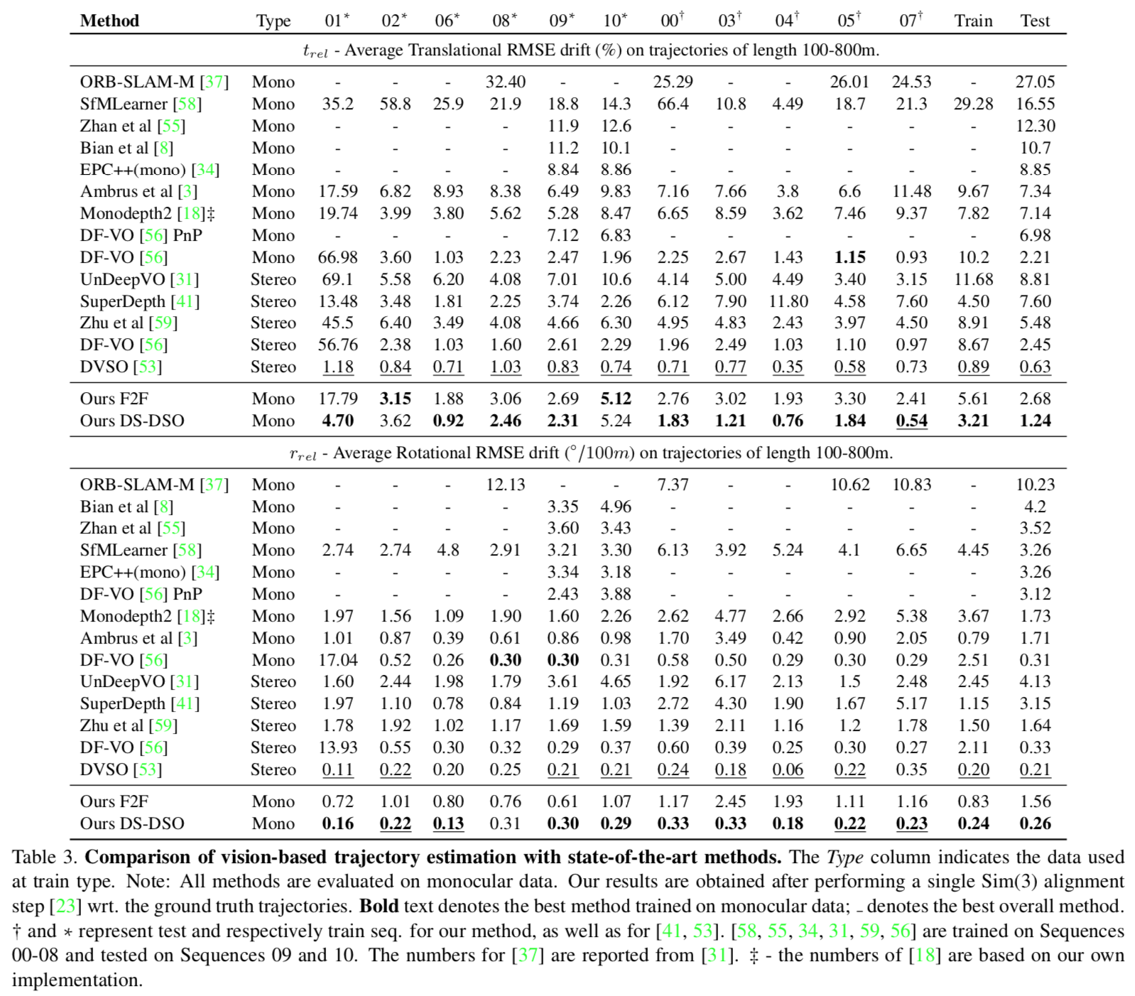
Visual Odometry
F2F worse than DF-VO[56]
DS-DSO works on par with stereo methods
Boosted by DSO

Slide 24
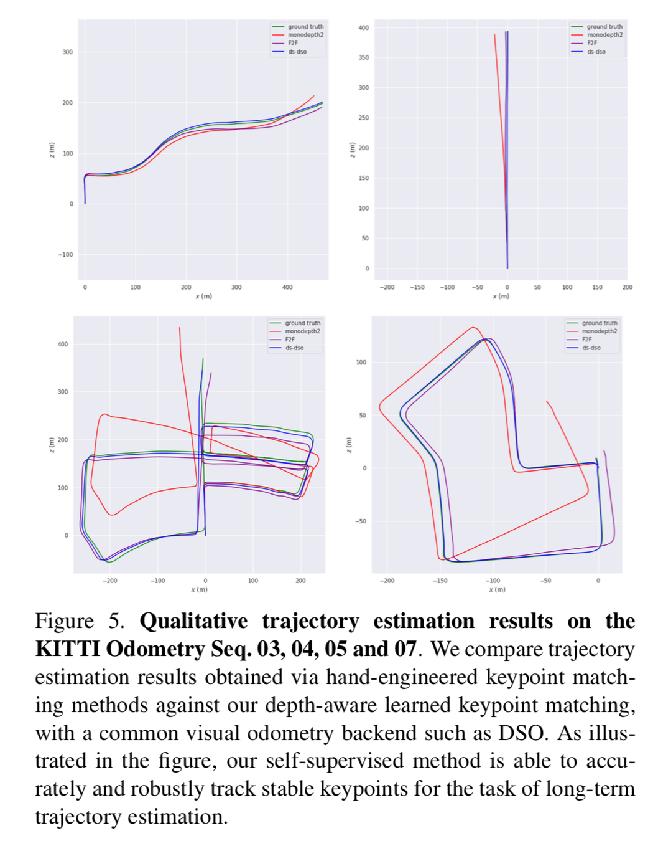
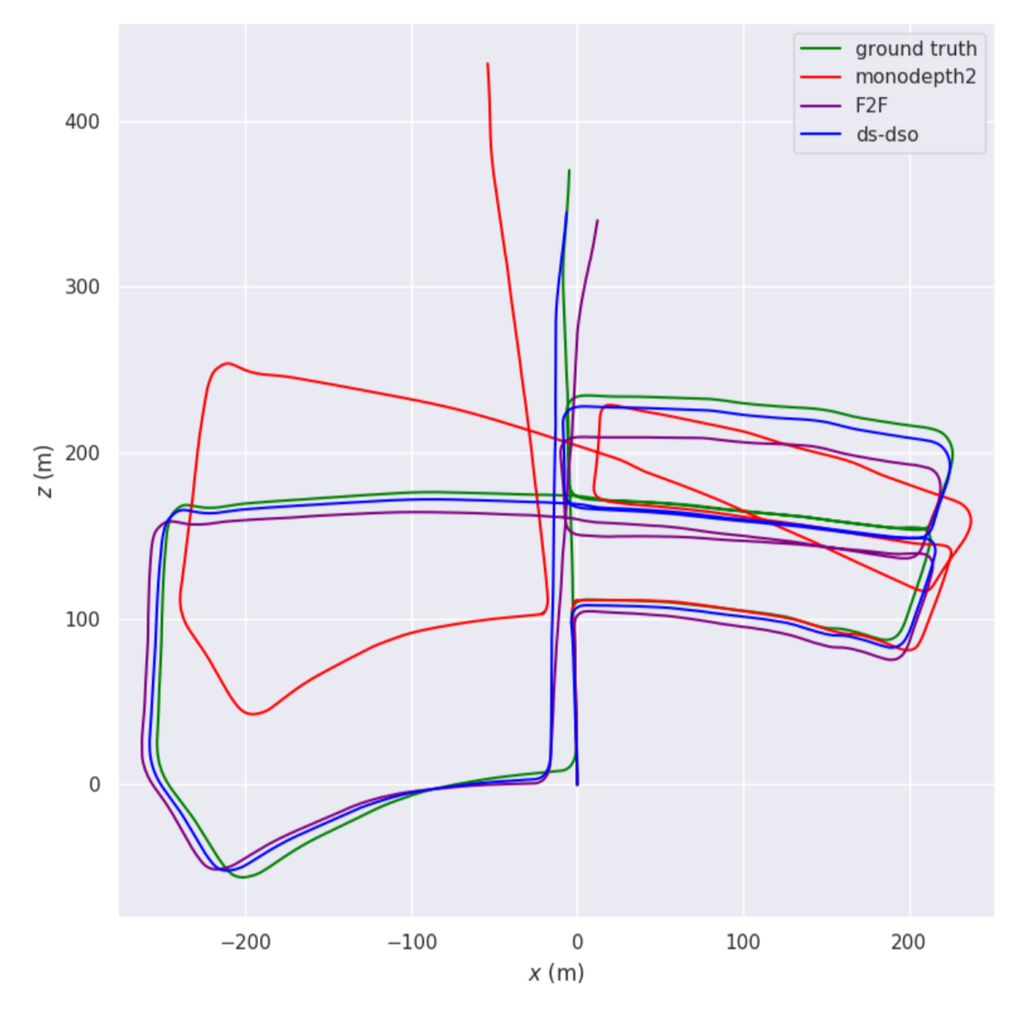
Visual odometry
Fair? Why choose monodepth2?

Slide 25
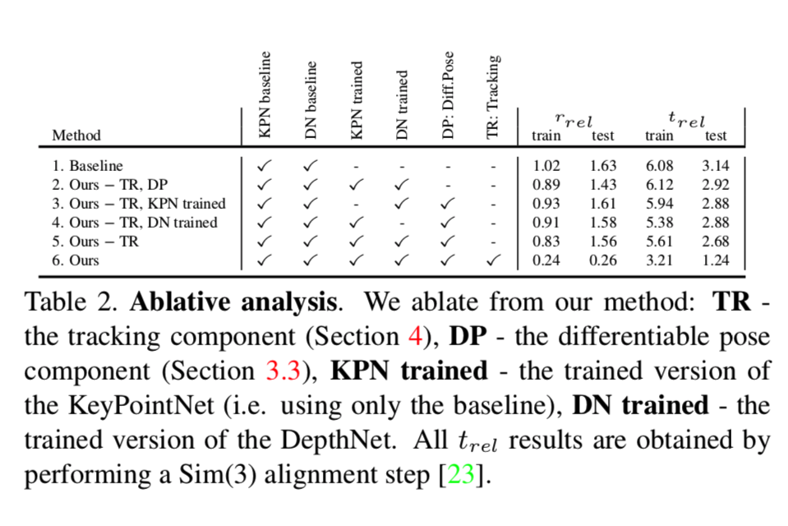
Ablation study
DSO improves a lot

Slide 26
Future work and discussion
First work to train detector and descriptor with multi-view adaptation
Experiments look somehow good
Only cover half of the visual odometry pipeline
DS-DSO is not end-to-end optimized

Slide 27
Outlines
Motivation and problem description
Brief summary of recent works
Self-Supervised 3D Keypoint Learning for Ego-motion Estimation
Optional: Visual Odometry Revisited: What Should Be Learnt?

Slide 28
Ian Reid is the Head of the School of Computer Science at the University of Adelaide
[2] Visual Odometry Revisited: What Should Be Learnt?
H Zhan, CS Weerasekera, J Bian, I Reid - arXiv preprint arXiv:1909.09803, 2019
Notes:
Ian Reid is the Head of the School of Computer Science at the University of Adelaide

Slide 29
Motivation

Slide 30
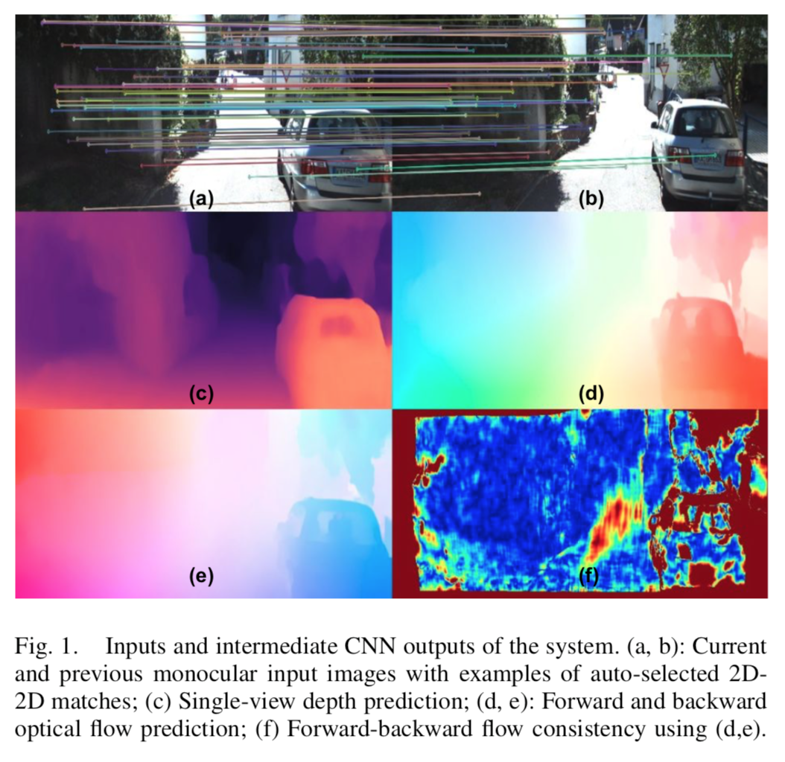
Method overview
Image
Depth prediction
Forward/ backward optical flow
Optical flow consistency
Sparse correspondences from optical flow consistency
3D-2D correspondences to estimate [R, t]

Slide 31
Method details and analysis
Depth prediction
Unsupervised photometric loss
Training in stereo for scale consistency
Optical flow
LiteFlowNet
Pre-trained in synthetic data
Unsupervised photometric loss
[35] C. Godard, O. Mac Aodha, M. Firman, and G. J. Brostow, “Digging into self-supervised monocular depth prediction,” October 2019.
[48] T.-W. Hui, X. Tang, and C. C. Loy, “Liteflownet: A lightweight con-volutional neural network for optical flow estimation,” in Proceedings of IEEE Conference on Computer Vision and Pattern Recognition (CVPR), June 2018, pp. 8981–8989.

Slide 32
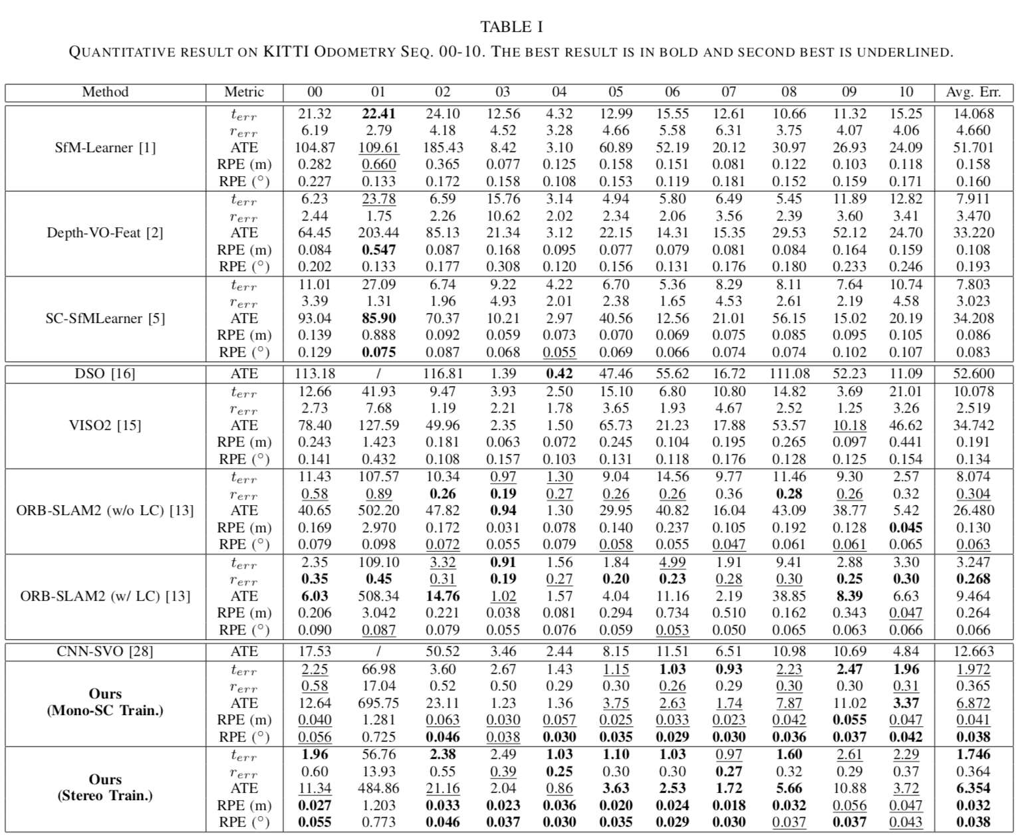
Experiments

Slide 33
Future work and discussion

Slide 34
References
[1] Self-Supervised 3D Keypoint Learning for Ego-motion Estimation
J Tang, R Ambrus, V Guizilini, S Pillai, H Kim, A Gaidon - arXiv preprint arXiv …, 2019
[2] Visual Odometry Revisited: What Should Be Learnt?
H Zhan, CS Weerasekera, J Bian, I Reid - arXiv preprint arXiv:1909.09803, 2019
[3] Beyond tracking: Selecting memory and refining poses for deep visual odometry
F Xue, X Wang, S Li, Q Wang, J Wang, H Zha - … of the IEEE Conference on Computer …, 2019
[4] Deep virtual stereo odometry: Leveraging deep depth prediction for monocular direct sparse odometry
N Yang, R Wang, J Stuckler, D Cremers - … of the European Conference on Computer …, 2018

Slide 35
Thank you

Slide 36
Backup

Slide 37
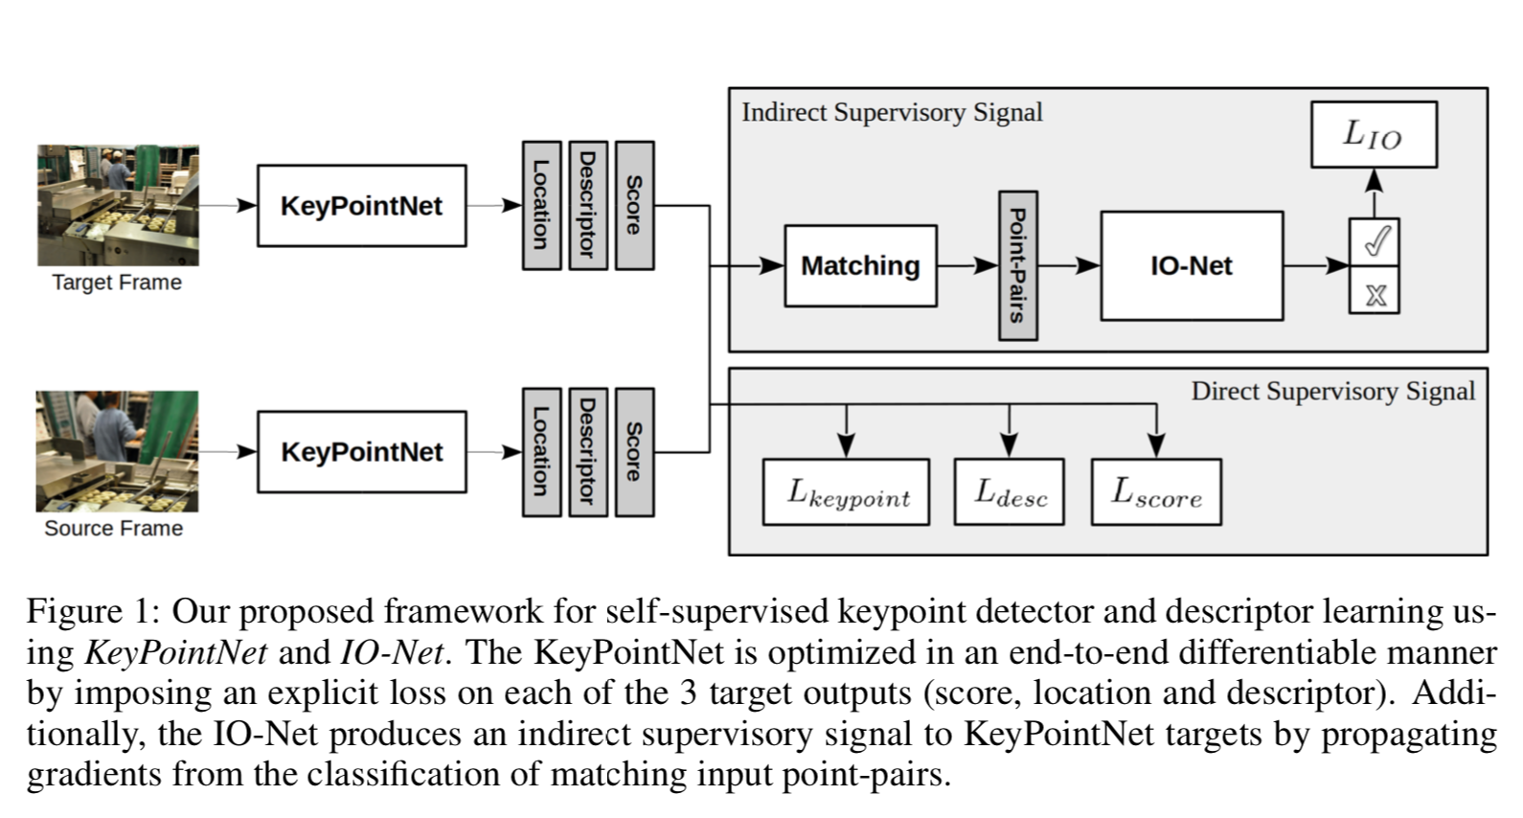
Pipeline
Neural Outlier Rejection for Self-Supervised Keypoint Learning
J Tang, H Kim, V Guizilini, S Pillai, R Ambrus - arXiv preprint arXiv:1912.10615, 2019

Slide 38
Network architecture
Neural Outlier Rejection for Self-Supervised Keypoint Learning
J Tang, H Kim, V Guizilini, S Pillai, R Ambrus - arXiv preprint arXiv:1912.10615, 2019

Slide 39
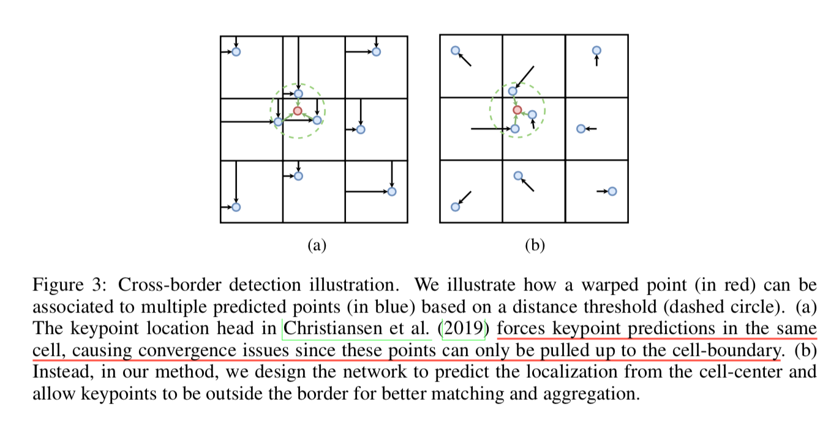
Keypoint regression

Slide 40
